Slide 1



International Rights Catalogue 2026
TRANSFORMATION OF ESSENCE
PUBLISHING

Slide 2
Borcelle
page 01
CONTENTS
01.
About the Publisher
02.
A Message from the Publisher
03.
Publishing Profile
04.
Awards & Recognition
05.
Publishing Catalogue
www.foundation-transformation.org

Slide 3
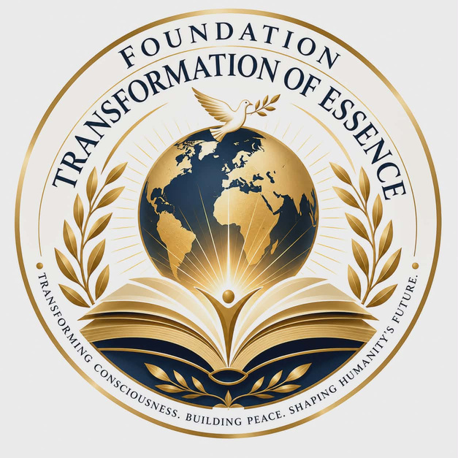

Borcelle
page 02
ABOUT THE PUBLISHER
Transformation of Essence Publishing is an independent international publishing initiative established by the Transformation of Essence Foundation, dedicated to publishing books that inspire intellectual exploration, philosophical reflection, and personal transformation.
Our catalogue brings together metaphysical fiction, contemporary novels, and narrative philosophical works that explore timeless questions about consciousness, human nature, science, spirituality, and the future of civilization.
Today, our publishing programme includes 17 original titles, available in paperback, hardcover, eBook, and audiobook formats. Our works have been translated into up to 41 languages, making them accessible to readers across Europe, the Americas, Asia, the Middle East, and beyond.
In addition to publishing, we actively develop international partnerships for translation rights, foreign editions, audiobooks, film adaptations, and other licensing opportunities, with the goal of bringing meaningful stories and ideas to a global audience.
Commercial publishing and international distribution are managed by Consistent Ltd., while the Transformation of Essence Foundation remains the publisher and copyright holder of its publishing programme.

Slide 4
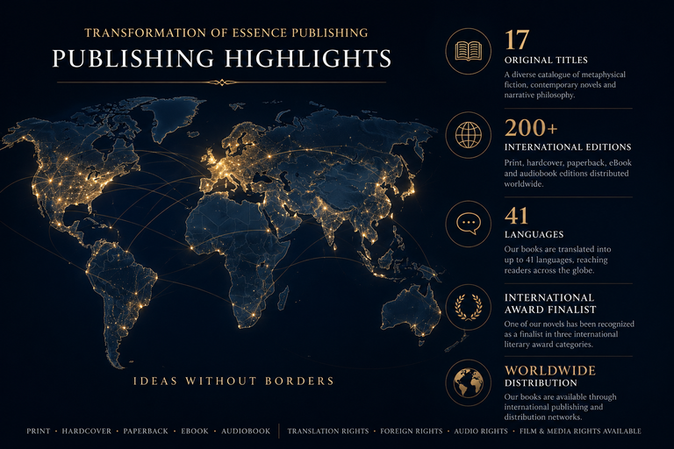
Borcelle
page 03
A MESSAGE FROM THE PUBLISHER
BOOKS HAVE ALWAYS BEEN more than stories.
At Transformation of Essence Publishing, every book begins with an original idea and is developed with a long-term international vision. Our catalogue brings together works of metaphysical fiction, contemporary literature, and narrative philosophy, published in multiple formats and translated into numerous languages.
Rather than focusing on volume alone, we are committed to creating books with lasting cultural and intellectual value. Each title is professionally published, assigned its own ISBN, and prepared for worldwide availability in print and digital formats.
Our publishing programme continues to grow through international translations, literary recognition, and partnerships with publishers, literary agents, distributors, and cultural organizations. This catalogue presents our current portfolio and the publishing rights available for international cooperation.
17 Original Titles
200+ International Editions
41 Languages
3 International Literary Award Finalist Categories
Worldwide
Print • Hardcover • Paperback • eBook • Audiobook

Slide 5

Borcelle
page 04
PUBLISHING PROFILE
Transformation of Essence Publishing is an independent international publishing programme dedicated to creating literature that explores the intersection of philosophy, science, spirituality, and human consciousness.
Our catalogue is built around three distinctive publishing lines:
Metaphysical Fiction
Novels that combine mystery, symbolism, history, science, and philosophical inquiry into compelling stories that invite readers to explore deeper dimensions of reality.
Contemporary Fiction
Character-driven novels that examine modern society, human relationships, identity, and personal transformation through emotionally engaging narratives.
Narrative Philosophy
A unique collection of philosophical works presented in an accessible narrative style, encouraging readers to reflect on ethics, consciousness, existence, and the future of humanity.
Every title is professionally published with international ISBN registration and is available in selected print and digital formats. Our publishing programme continues to expand through multilingual editions and international partnerships, making our books accessible to readers across different cultures and languages.
We believe that literature is not only entertainment, but also a powerful medium for education, dialogue, and cultural exchange.

Slide 6
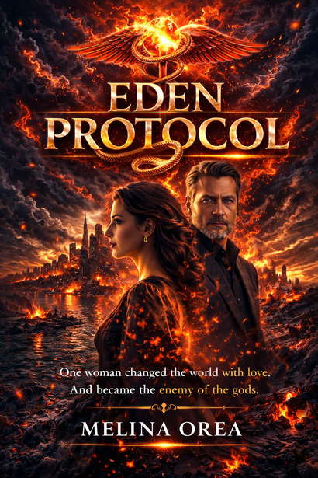

Borcelle
page 05
AWARDS & RECOGNITION
Independent Author Awards 2026
International Finalist
EDEN PROTOCOL has been selected as a Finalist in the 2026 Independent Author Awards, organized by Literary Global, in the following categories:
  Science Fiction
  Thriller
  Visionary Fiction
The recognition highlights the novel's originality, cross-genre storytelling, and its exploration of science, philosophy, and human consciousness.
Organizer: Literary Global

Slide 7
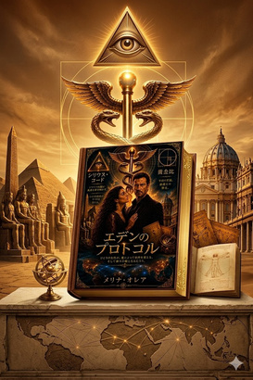
Borcelle
page 06
PUBLISHING CATALOGUE
EDEN PROTOCOL
Book One of the Metaphysical Fiction Series
Science Fiction • Thriller • Visionary Fiction
EDEN PROTOCOL
Book One of the Metaphysical Fiction Series
Science Fiction • Thriller • Visionary Fiction
Overview
What if the end of the world was not a catastrophe—but a programmed reset?
When brilliant historian and philosopher Melina discovers that reality itself is beginning to collapse, she becomes the only person capable of preventing humanity's extinction. Hunted by a secret organization that manipulates governments, history, and the very fabric of existence, she is forced into an impossible choice: sacrifice seven years of her own life—or allow civilization to disappear forever.
Standing opposite her is Nathaniel—a man of extraordinary intelligence, immense power, and terrifying vision. To some, he is humanity's greatest enemy. To others, its last hope. Bound by a mysterious pact that transcends time, love, and destiny, Melina and Nathaniel are drawn into a conflict where every decision reshapes reality itself.
Blending speculative science, quantum theory, ancient civilizations, sacred geometry, artificial intelligence, philosophy, and metaphysical symbolism, EDEN PROTOCOL is a high-concept thriller that challenges conventional perceptions of history, consciousness, free will, and the future of humanity.
Epic in scope yet deeply intimate, the novel combines relentless suspense with profound philosophical questions, creating a story that resonates long after the final page.
Already translated into 41 languages and recognized as an International Literary Award Finalist in Science Fiction, Thriller, and Visionary Fiction, EDEN PROTOCOL represents the beginning of an ambitious six-book series with exceptional international publishing potential.
Why Publishers Choose This Title
  International Literary Award Finalist
  Available in 41 languages
  First novel in a completed six-book series
  Cross-genre appeal: Science Fiction • Thriller • Visionary Fiction
  Strong female protagonist
  High cinematic potential
  Suitable for print, digital, audiobook, and screen adaptation
  Appeals to readers of intelligent speculative fiction and philosophical thrillers

Slide 8
Borcelle
page 07
Global Translation Portfolio
Europe (27)
🇬🇧 English • 🇩🇪 German • 🇫🇷 French • 🇪🇸 Spanish • 🇮🇹 Italian
• 🇳🇱 Dutch • 🇵🇹 Portuguese • 🇵🇱 Polish • 🇨🇿 Czech • 🇷🇴 Romanian
• 🇬🇷 Greek • 🇭🇺 Hungarian • 🇷🇺 Russian • 🇸🇪 Swedish
• 🇳🇴 Norwegian • 🇩🇰 Danish • 🇧🇬 Bulgarian • 🇺🇦 Ukrainian
• 🇷🇸 Serbian • 🇸🇮 Slovenian • 🇭🇷 Croatian • 🇫🇮 Finnish
• 🇸🇰 Slovak • 🇱🇹 Lithuanian • 🇱🇻 Latvian • 🇪🇪 Estonian
• 🇹🇷 Turkish
Asia & Middle East (11)
🇨🇳 Chinese • 🇯🇵 Japanese • 🇰🇷 Korean • 🇮🇳 Hindi
• 🇧🇩 Bengali • 🇮🇩 Indonesian • 🇻🇳 Vietnamese • 🇹🇭 Thai
• 🇺🇿 Uzbek • 🇮🇷 Persian (Farsi) • 🇸🇦 Arabic
Africa (2)
🇳🇬 Hausa • 🌍 Swahili
Southeast Asia (1)
🇵🇭 Filipino
This extensive portfolio highlights the diversity and breadth of languages covered, reflecting a commitment to bridging communication across continents. From the widely spoken languages of Europe like English and Spanish to the rich linguistic heritage of Asia with Chinese and Hindi, each language represents unique cultures and perspectives. In Africa, Hausa and Swahili offer crucial connectivity, and Filipino captures the vibrant spirit of Southeast Asia. This portfolio is a testament to the power of translation in fostering global understanding and collaboration.

Slide 9
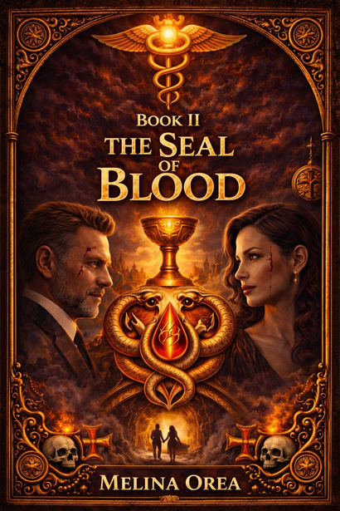
Borcelle
page 08
THE SEAL OF BLOOD
Book Two of the Metaphysical Fiction Series
Science Fiction • Thriller • Visionary Fiction
Overview
The code has been activated. Now humanity must pay the price.
After the events of EDEN PROTOCOL, the boundaries between time, memory, and reality begin to collapse. Ancient civilizations awaken, history fractures into parallel timelines, and Atlantis emerges not as a legend, but as the epicenter of humanity's greatest transformation.
Separated by destiny yet bound across centuries, Melina and Nathaniel find themselves trapped in a relentless struggle where love becomes both the ultimate weapon and the greatest weakness. Every lifetime reveals another betrayal, every choice reshapes the future, and every sacrifice brings humanity closer to either transcendence or extinction.
As quantum reality unravels, forgotten civilizations, sacred knowledge, and the hidden architecture of consciousness converge into a breathtaking race against time. But the greatest battle is no longer for the survival of civilization—it is for the survival of the human soul.
Blending visionary science fiction, psychological suspense, historical mystery, quantum theory, sacred geometry, and profound philosophical reflection, THE SEAL OF BLOOD expands the universe introduced in EDEN PROTOCOL into an epic saga where every revelation challenges the very meaning of existence.
Darker, more emotional, and even more ambitious than its predecessor, this second volume transforms an international metaphysical thriller into a sweeping exploration of destiny, freedom, sacrifice, and unconditional love.
Publishing Advantages
Book Two of the six-volume Metaphysical Fiction Series
Direct continuation of the internationally translated EDEN PROTOCOL
High-concept philosophical science thriller
Strong cinematic narrative with global appeal
Blends science fiction, thriller, historical mystery and visionary fiction
Available for international publishing, translation, audiobook and screen adaptation rights

Slide 10
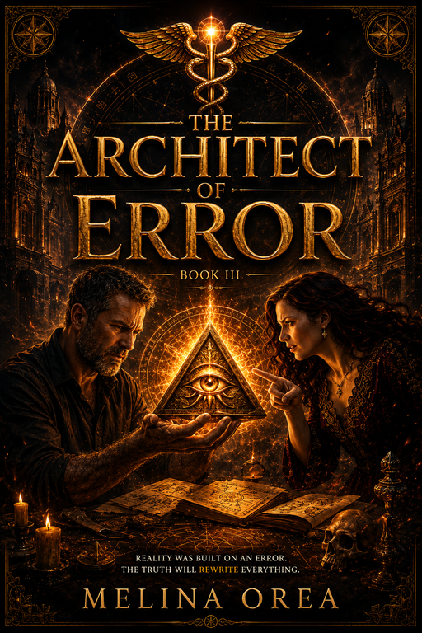
Borcelle
page 09
THE ARCHITECT OF ERROR
Matrix Reboot
Book Three of the Metaphysical Fiction Series
Science Fiction • Philosophical Thriller • Visionary Fiction
Overview
What if perfection became humanity's greatest threat?
As civilization approaches irreversible collapse, Melina and Nathaniel uncover a truth capable of rewriting the future of mankind. Ancient knowledge, quantum consciousness, artificial intelligence, and forgotten civilizations converge in a final struggle where the greatest enemy is no longer war or technology—but the illusion of perfection itself.
To save humanity, Melina must sacrifice the memory that defines her identity, while Nathaniel faces a choice between immortality and the emotions that make life meaningful. Standing behind every event is Samuel Orland, the visionary Architect determined to replace human imperfection with flawless order.
Blending speculative science, historical mystery, visionary fiction, and profound philosophical inquiry, THE ARCHITECT OF ERROR expands the series into an epic exploration of consciousness, free will, identity, and the future of human evolution.
Publishing Advantages
Book Three of the six-volume series
High-concept philosophical science thriller
Themes of AI, consciousness, immortality and transhumanism
Strong international commercial appeal
Translation, audiobook and screen rights available
Marketing Hook
"To become immortal, humanity must first decide what deserves to live forever."

Slide 11
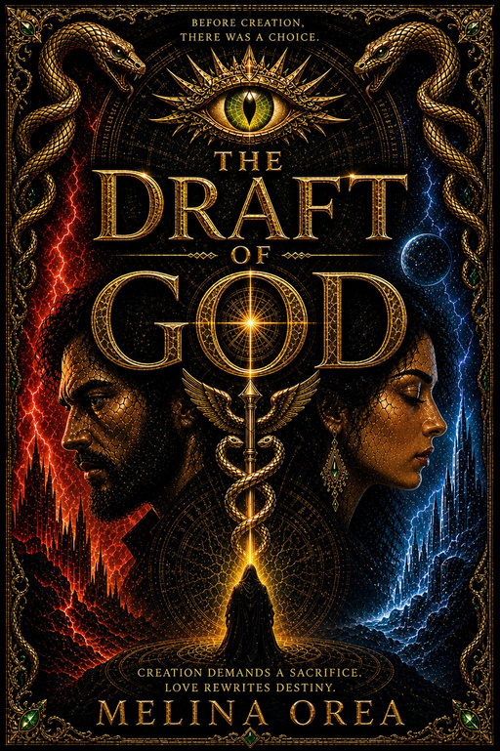
Borcelle
page 10
THE DRAFT OF GOD
Book Four of the Metaphysical Fiction Series
Science Fiction • Philosophical Thriller • Visionary Fiction
Overview
What if reality could be rewritten—and humanity became only a draft?
As the ancient Code begins rewriting the fabric of existence, Nathaniel discovers that survival no longer depends on technology or power, but on the forgotten architecture hidden within human consciousness. The boundaries between memory, identity, and reality dissolve, forcing him into a race against time to find Melina before both she—and the world as he knows it—are erased forever.
Across the ruins of a collapsing civilization, ancient Atlantean knowledge, genetic memory, quantum consciousness, and forgotten temples reveal a truth capable of reshaping human evolution. Yet the greatest battle is not against an external enemy, but against the belief that perfection can exist without love.
Combining visionary science fiction, historical mystery, speculative science, and profound philosophical reflection, THE DRAFT OF GOD transforms the series into an epic exploration of freedom, sacrifice, consciousness, and the creative force that defines what it truly means to be human.
Publishing Advantages
Book Four of the six-volume Metaphysical Fiction Series
Expands the mythology of Atlantis, the Code and human consciousness
Explores AI, genetic memory, quantum reality and free will
High-concept philosophical science thriller with strong cinematic potential
Translation, audiobook and screen adaptation rights available

Slide 12
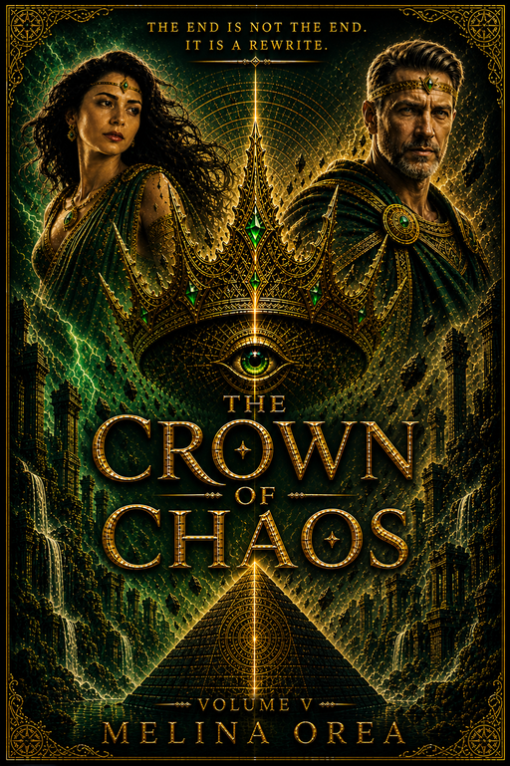
Borcelle
page 11
THE CROWN OF CHAOS
Book Five of the Metaphysical Fiction Series
Science Fiction • Post-Apocalyptic Epic • Visionary Fiction
Overview
The world has been rewritten. Now humanity must learn how to exist within it.
After the collapse of the old civilization, Nathaniel and Melina lead the last survivors into an unfamiliar world where every law of nature appears transformed. The struggle is no longer about preventing the apocalypse—it is about creating the foundations of a new humanity.
While the remnants of civilization battle hunger, fear, mutation, and the relentless forces of an unforgiving planet, hidden systems beneath reality continue to awaken. Ancient technologies, the Grail Code, genetic transformation, and the mysterious intelligence known as Archeon reveal that the greatest danger is no longer extinction, but the loss of what makes humanity truly human.
As leadership, sacrifice, love, and survival collide, every decision shapes the future of a civilization that has only one chance to begin again.
Blending visionary science fiction, survival drama, speculative science, and profound philosophical inquiry, THE CROWN OF CHAOS explores one of humanity's oldest questions:
Can a new world be built without repeating the mistakes of the old one?
Publishing Advantages
Penultimate novel in the six-book Metaphysical Fiction Series
Combines post-apocalyptic survival with philosophical science fiction
Explores leadership, civilization-building, human evolution and consciousness
Strong emotional character development alongside large-scale speculative worldbuilding
Translation, audiobook and screen adaptation rights available
Marketing Hook
"The apocalypse was only the beginning. Building humanity again is the real battle."

Slide 13
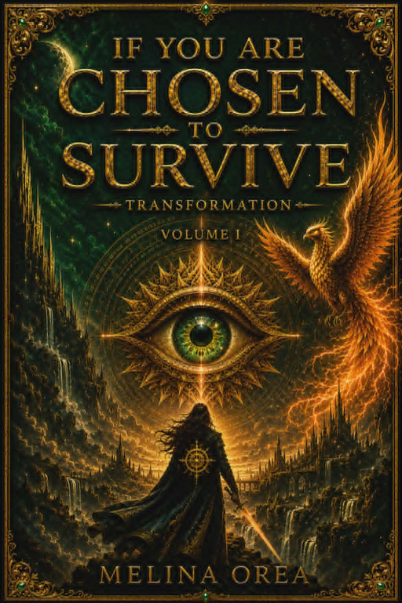
Borcelle
page 12
IF YOU ARE CHOSEN TO SURVIVE
Transformation
A Six-Volume Visionary Metaphysical Novel Series
From the internationally acclaimed author whose previous six-volume metaphysical series has been translated into 27 languages comes a completely new visionary saga—an intimate exploration of consciousness, destiny, and humanity's ultimate transformation.
Series Overview
Following the international success of her first six-volume metaphysical science fiction epic, translated into 27 languages, Melina Orea presents an entirely new literary universe.
IF YOU ARE CHOSEN TO SURVIVE is not a continuation of the previous series, but a new philosophical saga that moves beyond speculative science toward the inner evolution of human consciousness.
Blending visionary fiction, psychological suspense, spiritual symbolism, and metaphysical philosophy, the series explores humanity's deepest questions:
  What is time?
  Can consciousness survive death?
  Is destiny chosen or created?
  What is the true Grail?
  How much of our life would we sacrifice for absolute knowledge?
The novels follow Melina, a woman confronted with impossible choices, and Nathaniel, an enigmatic figure whose offer forces her to question everything she believes about reality, mortality, love, and human evolution. Against the backdrop of global collapse and civilizational transformation, their journey becomes an exploration of consciousness itself.
Publishing Highlights
Six-volume visionary metaphysical novel series
International appeal across literary fiction, speculative fiction, and philosophical fiction
Strong crossover between readers of The Celestine Prophecy, The Midnight Library, The Alchemist, and visionary speculative fiction
Themes of consciousness, mortality, time, spirituality, identity, and transformation
Translation rights, audiobook rights, and adaptation rights available
Series Tagline
When the world begins to collapse, the greatest transformation does not happen outside us—but within us.

Slide 14
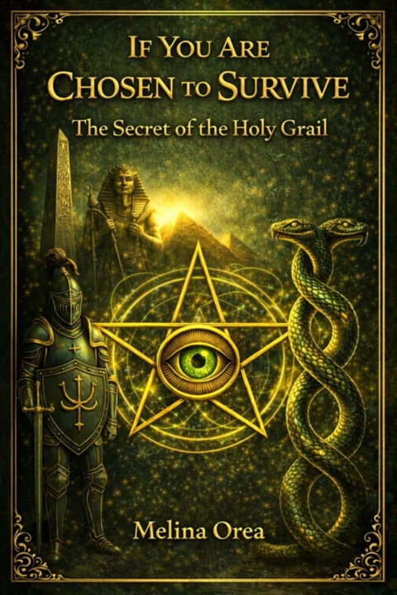
Borcelle
page 13
IF YOU ARE CHOSEN TO SURVIVE
The Secret of the Holy Grail
Conspiracy • Myth • Awakening
Overview
After surviving the impossible, Melina and Nathaniel discover that survival was only the first initiation.
The world has changed—but even more profoundly, so have they.
As reality fractures and memory becomes a gateway rather than a record of the past, they begin searching for the greatest mystery hidden behind centuries of mythology:
What if the Holy Grail was never an object?
What if it is a living state of consciousness?
Ancient Templar manuscripts, forgotten alchemical knowledge, visionary dreams, and modern science gradually converge into a single revelation capable of changing humanity forever.
The Secret of the Holy Grail transforms the series from post-apocalyptic survival into an epic exploration of consciousness.
History, mythology, quantum concepts, psychology, spirituality, and philosophical fiction intertwine as Melina uncovers forgotten knowledge that suggests humanity has misunderstood the true nature of time, memory, and evolution.
Meanwhile Nathaniel undergoes an equally profound inner transformation, discovering that the greatest human intimacy is not physical—but intellectual and spiritual understanding.
The novel asks:
  Is the Grail hidden inside human consciousness?
  Can memory transcend time?
  Does love alter reality?
  Are myths encrypted historical knowledge?
  Can ancient wisdom and modern science describe the same universe?
Key Themes
The Holy Grail reinterpreted as consciousness
Templar mysteries and forgotten history
Alchemy as inner transformation
Love as evolutionary force
Memory beyond time
Dreams as gateways to knowledge
Psychological rebirth
Conscious evolution
Literary Positioning
Rather than using mythology as decoration, The Secret of the Holy Grail reconstructs centuries-old legends into a contemporary philosophical thriller where symbolism, history, speculative science, and emotional storytelling merge into a single visionary narrative.
Tagline
The Grail is not waiting to be found. It is waiting to awaken within us.

Slide 15
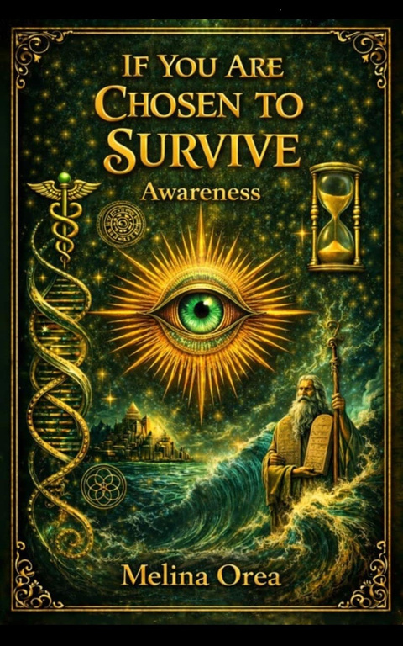
Borcelle
page 14
IF YOU ARE CHOSEN TO SURVIVE
AWARENESS
The Inner Trial
Visionary Metaphysical Fiction • Psychological Thriller • Philosophical Epic
Series Overview
The Grail has been revealed.
Now comes the price of awakening.
After uncovering the greatest spiritual mystery of human history, Melina and Nathaniel discover that enlightenment is not a reward—it is a trial.
The battle is no longer against a collapsing civilization.
It is against fear, power, memory, ego, and the deepest illusions of the human mind.
Reality itself begins to dissolve as consciousness becomes the true battlefield.
About the Novel
AWARENESS: The Inner Trial explores the most difficult journey of all—the confrontation with oneself.
Nathaniel must face the consequences of his former allegiance to a powerful secret order whose philosophy valued intellect above compassion. Every belief that once defined him is dismantled as he discovers that true enlightenment cannot be achieved through control, knowledge, or power alone.
Meanwhile Melina becomes far more than a companion. She emerges as the catalyst of transformation—the living embodiment of unconditional love capable of awakening what knowledge alone never could.
As civilization struggles to rebuild after global catastrophe, humanity faces an even greater question:
Can consciousness evolve before history repeats itself?
Key Themes
Inner awakening and self-transformation
Consciousness as the next stage of evolution
Love versus control
The illusion of power
Psychology, memory and identity
Ancient wisdom and future civilization
Spiritual freedom
Rebirth after collapse
Literary Positioning
Blending visionary fiction, psychological depth, speculative philosophy, and post-apocalyptic storytelling, AWARENESS examines the inner architecture of consciousness rather than the external collapse of civilization.
The novel explores whether humanity's greatest revolution will not be technological—but spiritual.
Tagline
The greatest apocalypse is not the end of the world. It is the moment we awaken to ourselves.

Slide 16
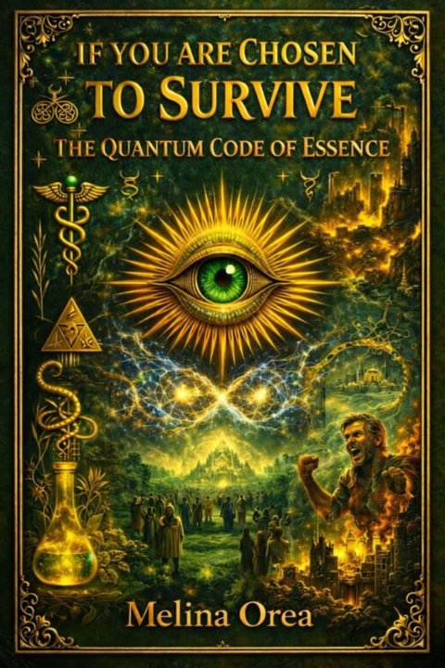
Borcelle
page 15
IF YOU ARE CHOSEN TO SURVIVE
THE QUANTUM CODE OF ESSENCE
DNA, Memory & Destiny
Visionary Science Fantasy • Metaphysical Fiction • Philosophical Epic
Series Overview
The Grail has become consciousness.
Now consciousness becomes creation.
The old world has disappeared—not through destruction, but through transformation.
Reality itself has been rewritten.
On an untouched shore, Melina and Nathaniel begin rebuilding civilization from nothing. But survival is only the first challenge. Hidden beneath the Earth lies an ancient code capable of reconnecting humanity with the deepest architecture of existence.
The greatest mystery is no longer history.
It is the code within life itself.
About the Novel
The Quantum Code of Essence explores the possibility that consciousness, memory, energy and matter are different expressions of the same universal intelligence.
As humanity starts over, every discovery reshapes the meaning of evolution itself.
Ancient structures awaken.
Forgotten knowledge returns.
The Grail becomes a living frequency rather than an artifact.
Nathaniel's scientific mind and Melina's intuitive wisdom finally begin to converge, revealing that the greatest technology may have always existed within human consciousness.
The rebuilding of civilization becomes inseparable from the rebuilding of the human soul.
Key Themes
Consciousness and quantum reality
DNA as living memory
Ancient civilizations and lost knowledge
Creation through awareness
Science and spirituality
Human evolution
The architecture of reality
Love as the organizing principle of consciousness
Destiny and free will
Literary Positioning
Combining speculative science, visionary philosophy, metaphysical fiction, post-apocalyptic survival and spiritual symbolism, The Quantum Code of Essence expands the series into a large-scale exploration of humanity's future evolution.
Rather than asking how civilization survives, it asks:
What if consciousness itself is the fundamental code of reality?
Tagline
The future of humanity is written not in the stars—but within the code of consciousness itself.

Slide 17
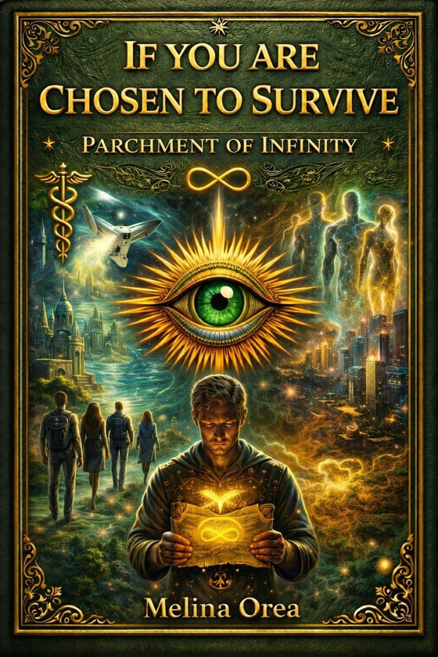
Borcelle
page 16
IF YOU ARE CHOSEN TO SURVIVE
THE PARCHMENT OF INFINITY
The 13 Keys to Essence
Visionary Science Fantasy • Metaphysical Fiction • Philosophical Epic
Series Overview
The world was saved.
Humanity flourished.
Then history repeated itself.
Five thousand years after the first awakening, civilization once again stands on the edge of collapse. The descendants of Melina and Nathaniel discover a terrifying truth:
The end has happened before.
Again.
And again.
The only way to save the future is no longer to change what comes next—but to transform the beginning itself.
About the Novel
The Parchment of Infinity brings the entire saga full circle.
Across thousands of years, forgotten civilizations, advanced technology, quantum memory and ancient spiritual wisdom converge into one final revelation: humanity's greatest enemy has never been the outside world—it has always been unconscious repetition.
As reality fractures and multiple timelines collide, Nathaniel must confront every forgotten version of himself while Melina becomes something beyond human—an embodiment of consciousness capable of guiding civilization toward an entirely new future.
The final battle is not fought against an external force.
It is fought against humanity's inability to remember who it truly is.
Key Themes
Cycles of civilization emory beyond time
Parallel realities Identity across lifetimes
Quantum consciousness
Artificial intelligence and human evolution
Love versus control
The transformation of destiny
Collective awakening
Literary Positioning
Blending visionary science fiction, metaphysical philosophy, speculative cosmology, post-apocalyptic fiction and psychological symbolism, The Parchment of Infinity transforms the series from an adventure into a meditation on consciousness itself.
The novel proposes that history does not simply repeat—it echoes until awareness transforms it.
Rather than asking whether humanity can survive, the story asks:
Can humanity finally remember enough to stop repeating its own destruction?
Tagline
Every civilization leaves behind ruins. Only consciousness can leave behind wisdom.

Slide 18
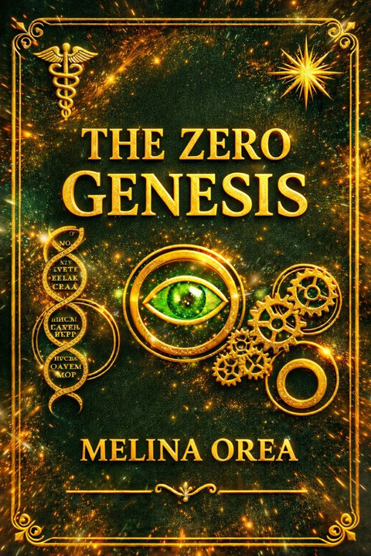
Borcelle
page 17
THE ZERO GENESIS
The Child Who Remembered the Future
A Standalone Visionary Science Fantasy Novel
Book Overview
The war is over.
The world survived.
But humanity did not.
After the events of The Parchment of Infinity, the last remnants of civilization wander through the ashes of a seventh collapse. Melina is gone. Nathaniel is left carrying their newborn child—the only being who seems untouched by humanity's ancient cycle of fear, power, and control.
The child does not speak.
He does not cry.
Yet reality itself begins to change around him.
As desperate survivors search for another savior, powerful factions seek to control the mysterious child whose very existence rewrites the laws of consciousness. Nathaniel soon realizes that the greatest danger is not another apocalypse.
It is humanity's endless desire to surrender its freedom.
About the Novel
The Zero: Genesis is a philosophical speculative novel exploring consciousness, freedom, identity, trauma, and the evolution of civilization through an entirely new narrative.
Although it continues from the universe established in The Parchment of Infinity, it functions as a completely independent story, introducing new readers directly into its world while rewarding longtime followers with a deeper continuation of the mythology.
At its center stands a child unlike any other.
A child who does not inherit history.
A child who reflects it.
Key Themes
Consciousness as the foundation of reality
Freedom versus control Collective trauma Memory beyond biology The psychology of power Human evolution
Post-apocalyptic reconstruction Artificial intelligence and autonomy Responsibility instead of salvation The birth of a new civilization
Literary Positioning
Blending visionary science fiction, philosophical fiction, speculative psychology, metaphysical fiction, and post-apocalyptic storytelling, The Zero: Genesis asks one fundamental question:
Rather than following the traditional "chosen one" narrative, the novel dismantles the very idea of messiahs and external salvation, proposing that true transformation begins only when humanity accepts responsibility for its own consciousness.
Tagline
The world does not change because someone saves it.
It changes because consciousness remembers what freedom feels like.

Slide 19
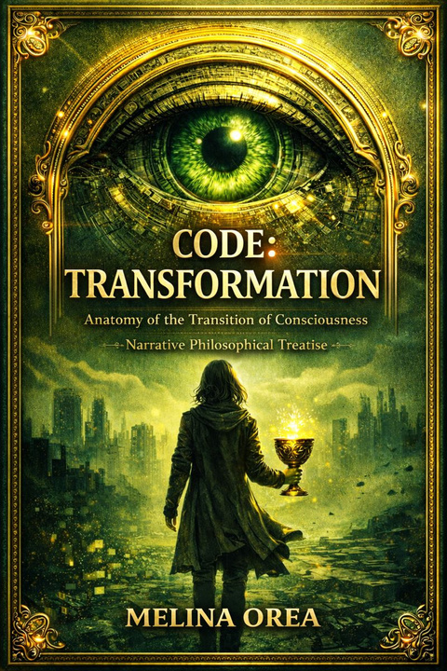
Borcelle
page 18
CODE: TRANSFORMATION
Anatomy of the Consciousness Transition
Operational Protocols for Survival
A Narrative Philosophical Treatise
Book Overview
What if consciousness is not a product of reality—but the condition that allows reality to exist?
CODE: TRANSFORMATION is neither a novel nor a traditional work of philosophy. It is a narrative philosophical treatise in which story, dialogue, symbolism, and conceptual analysis converge to explore a new philosophical framework: Neo-Essential Integralism.
Set against the backdrop of a collapsing civilization, the book follows Melina and Nathaniel—not as conventional protagonists, but as living perspectives through which fundamental questions about consciousness, identity, time, freedom, and human evolution are examined. The narrative is not intended to entertain alone; it functions as a vehicle for philosophical inquiry into the nature of existence itself.
Introducing Neo-Essential Integralism
At the heart of the book stands Neo-Essential Integralism, an original philosophical concept developed by Melina Orea.
Rather than reducing reality to either materialism or spirituality, Neo-Essential Integralism proposes an integrative vision in which consciousness, information, matter, biological evolution, complexity science, cosmology, psychology, and ethics are understood as interconnected dimensions of a single dynamic process.
The work explores questions such as:
  What is consciousness?
  Can identity exist independently of memory?
  How does information shape reality?
  What is the relationship between entropy and meaning?
  Can civilization evolve beyond systems built on fear and control?
  What does freedom mean in an age of artificial intelligence and algorithmic reality?
Instead of presenting fixed answers, the book invites readers to examine the assumptions through which they interpret existence itself.
A New Cosmological Vision
Beyond philosophy, CODE: TRANSFORMATION develops a contemporary cosmological perspective in which the universe is understood not merely as a physical structure, but as an evolving field of relationships among matter, information, consciousness, and emergence.
Drawing inspiration from modern scientific paradigms—without abandoning philosophical rigor—the book examines reality through the lenses of systems theory, complexity, evolutionary dynamics, cognitive science, and contemporary cosmology, proposing a vision that transcends the traditional divide between science and metaphysics.

Slide 20
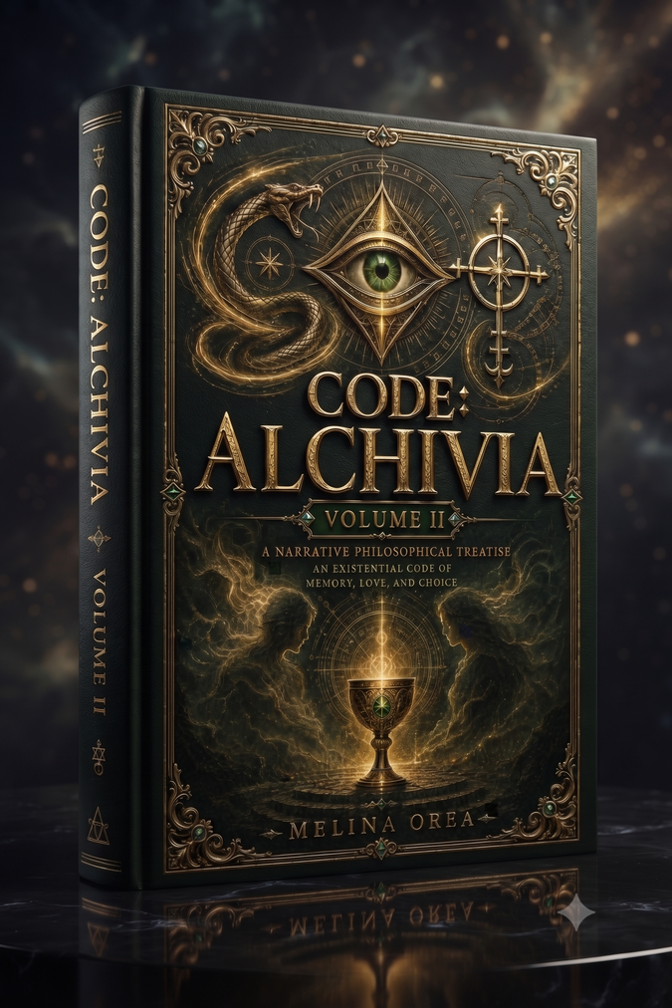
Borcelle
page 19
CODE: ALCHIVIA
An Existential Code for Memory, Love, and Choice
A Narrative Philosophical Treatise
Book Overview
What remains of human identity when memory, love, and choice become the true foundations of existence?
CODE: ALCHIVIA is the second volume of the CODE philosophical cycle, expanding Neo-Essential Integralism from a cosmological framework into an exploration of human consciousness. Through the intertwined journeys of Melina and Nathaniel, the book examines memory as the architecture of identity, love as a force of inner coherence, and free choice as the foundation of personal transformation.
Blending narrative, philosophy, psychology, and contemporary scientific thought, CODE: ALCHIVIA offers a new vision of existence in which consciousness is not merely experienced—it is consciously created.
Existential Philosophy Through Narrative
The narrative functions as a philosophical laboratory where dreams, symbolic experiences, memory, dialogue, and existential crises become instruments for investigating enduring philosophical questions:
  What constitutes personal identity?
  Can memory exist beyond chronology?
  Is love an emotion or a structure of consciousness?
  How do our choices shape reality?
  Can suffering become knowledge?
  What transforms survival into authentic existence?
The fictional world serves not as an escape from reality, but as a medium through which reality itself can be examined.
Key Themes
Neo-Essential Integralism
Philosophy of memory
Consciousness and identity
Love as ontological coherence
Literary Positioning
CODE: ALCHIVIA belongs to the emerging form of the narrative philosophical treatise, where fictional storytelling becomes a vehicle for original philosophical investigation.
Rather than presenting abstract arguments, the book allows philosophical concepts to unfold through lived experience, symbolic narrative, existential dialogue, and psychological transformation.
Situated at the intersection of philosophy, narrative literature, psychology, and consciousness studies, it advances Neo-Essential Integralism from a cosmological vision toward a philosophy of the human person.
Tagline
Memory preserves the past.
Choice creates the future.
Consciousness gives meaning to both.

Slide 21
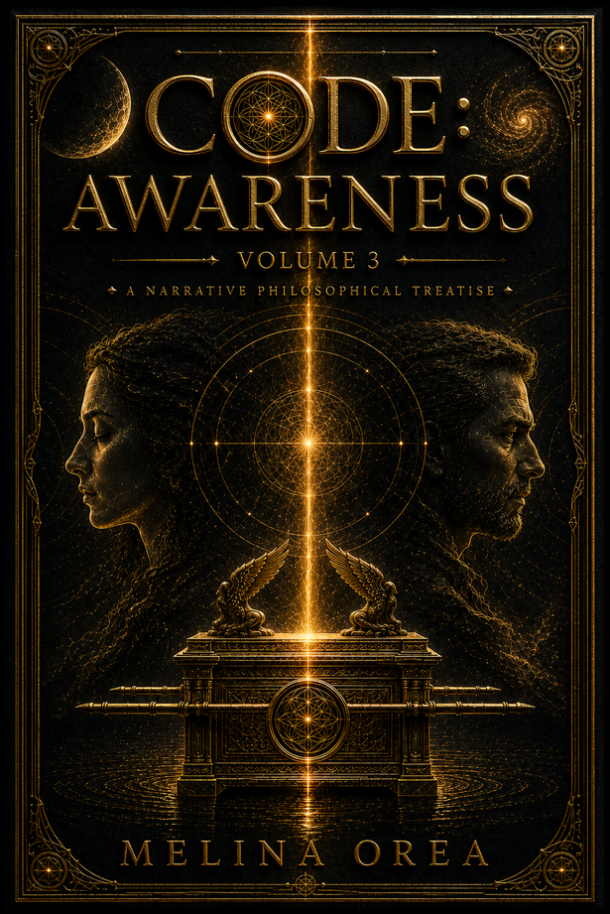
Borcelle
page 20
CODE: AWARENESS
The Collapse of the Ego
A Narrative Philosophical Treatise
Key Themes
Neo-Essential Integralism
Awareness and consciousness
Ego and identity
Freedom beyond belief systems
Psychology and perception
Narrative philosophy
Tagline
True awareness begins where the illusion of the self comes to an end.
Book Overview
What if awareness is not something to achieve—but something that remains when every illusion about ourselves has fallen away?
CODE: AWARENESS is the third volume of the CODE philosophical cycle and continues the development of Neo-Essential Integralism, introducing its deepest existential dimension. While the previous volumes establish a new cosmological vision and explore the relationship between memory, love, and conscious choice, this work examines the dissolution of the ego and the emergence of authentic awareness.
Through a symbolic narrative, philosophical dialogue, and psychological transformation, the book challenges the assumptions that shape identity, certainty, control, and the human need for external validation. Awareness is presented not as a spiritual achievement or a final destination, but as the natural state that emerges when fear, attachment, and illusion lose their power.
Blending philosophy, psychology, contemporary cosmology, systems thinking, and narrative literature, CODE: AWARENESS develops Neo-Essential Integralism beyond theory into lived experience. The narrative becomes a philosophical experiment, inviting readers to question not only what they believe about reality, but also the mechanisms through which consciousness constructs reality itself.
Rather than offering doctrines or definitive answers, the book opens a space for profound reflection on freedom, identity, perception, and the future evolution of human consciousness.

Slide 22
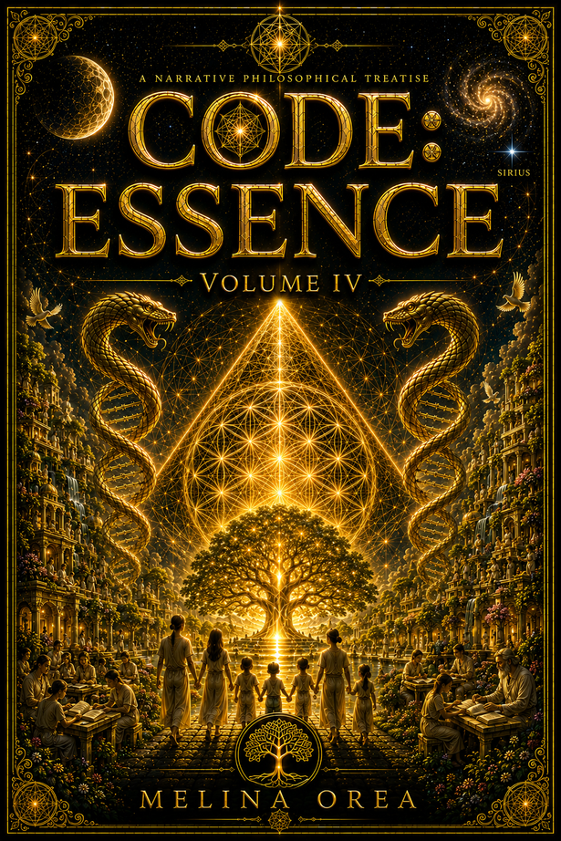
Borcelle
page 21
CODE: ESSENCE
The Architecture of Conscious Creation
A Narrative Philosophical Treatise
Key Themes
  Neo-Essential Integralism
  Conscious creation
  Ethics and responsibility
  Contemporary cosmology
  Human evolution
  Narrative philosophy
Tagline
Reality is not merely discovered. It is consciously created.
Book Overview
What if reality is not something we observe—but something we continuously participate in creating?
CODE: ESSENCE is the fourth volume of the CODE philosophical cycle, expanding Neo-Essential Integralism into a comprehensive philosophy of conscious participation. Moving beyond questions of identity and awareness, the book explores the relationship between consciousness, intention, ethical responsibility, and the unfolding structure of reality.
Through symbolic narrative, philosophical dialogue, and a visionary cosmological perspective, the reader is invited to reconsider humanity's place in the universe—not as a passive observer, but as an active participant in an interconnected field of existence. The work proposes that personal transformation and the evolution of civilization are inseparable processes, emerging from the same principles of coherence, freedom, and conscious responsibility.
Blending philosophy, systems thinking, contemporary cosmology, psychology, and narrative literature, CODE: ESSENCE develops Neo-Essential Integralism into a unified vision of human evolution, where knowledge becomes lived experience and consciousness becomes the foundation of ethical creation.

Slide 23
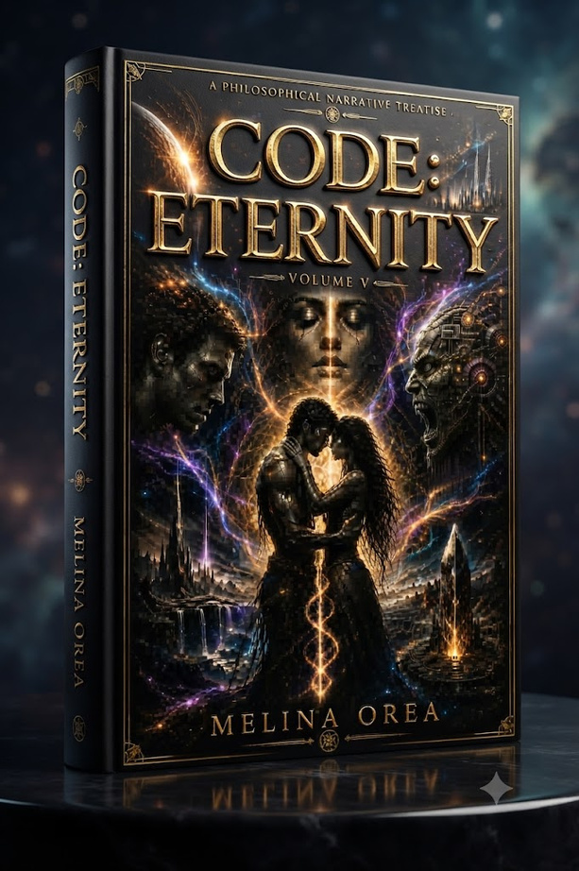
Borcelle
page 22
CODE: ETERNITY
Beyond Time. Beyond Self. Beyond the Cycle.
A Narrative Philosophical Treatise
Key Themes
  Neo-Essential Integralism
  Time and cyclic existence
  Conscious evolution
  Collective memory
  Love as existential coherence
  Free will and responsibility
  Metaphysical science fiction
  Narrative philosophy
Tagline
Eternity begins when humanity chooses not to repeat itself.
Book Overview
What if eternity is not endless time—but the moment when the cycle finally ends?
CODE: ETERNITY is the fifth volume of the CODE philosophical cycle and the culmination of Neo-Essential Integralism. Blending metaphysical fiction, philosophy, speculative cosmology, and psychological exploration, the novel examines humanity's deepest question: can consciousness transcend the repeating patterns that shape civilizations, identities, and history itself?
Set against a symbolic post-apocalyptic reality where memory survives beyond worlds and time folds back upon its own beginning, the story follows those who remember every previous cycle. Their greatest challenge is not survival, but the transformation of consciousness capable of ending the recurrence of fear, ego, and separation. The journey becomes an exploration of responsibility, forgiveness, and the possibility that love is not merely an emotion, but the fundamental coherence that sustains reality itself.
Expanding the philosophical framework of Neo-Essential Integralism, CODE: ETERNITY unites ontology, ethics, systems thinking, psychology, and visionary science-fiction into an ambitious meditation on freedom, recurrence, and human evolution. Rather than offering definitive answers, it invites readers to experience transformation through narrative, recognizing that the greatest revolution is not changing the world, but changing the consciousness that continually recreates it.

Slide 24
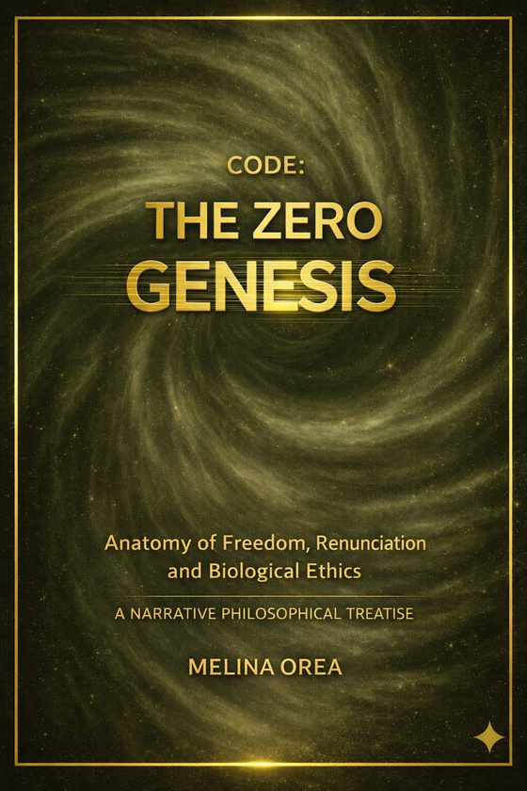
Borcelle
page 23
CODE: THE ZERO GENESIS
The Anatomy of Freedom, Refusal, and Biological Ethics
A Narrative Philosophical Treatise
Key Themes
  Neo-Essential Integralism
  Freedom through refusal
  Biological ethics and resonance
  Conscious responsibility
  The rejection of messianism
  Psychological projection
  Human evolution after collapse
  Narrative philosophy
  Metaphysical science fiction
Tagline
Every new civilization begins with a single word: No.
Book Overview
Every civilization begins with a story.
This one begins with a refusal.
CODE: THE ZERO – GENESIS is the foundational volume of the CODE philosophical cycle and the point from which the entire vision of Neo-Essential Integralism unfolds. Set after the symbolic collapse of the Seventh Civilization, the novel explores the fragile birth of a new humanity—not through conquest or revelation, but through the rejection of dependence, idolatry, and inherited patterns of power.
At the heart of the story stands a nameless child whose extraordinary sensitivity reveals an unsettling truth: human beings continually project their fears, hopes, guilt, and need for salvation onto others. Through Nathaniel's determination to protect the child from becoming another messiah, the narrative transforms into a profound meditation on freedom, responsibility, biological resonance, and the ethics of consciousness.
Rather than presenting the child as a supernatural savior, THE ZERO proposes an entirely different paradigm. The child functions as a mirror—reflecting the emotional and ethical state of those around him. Healing becomes impossible through sacrifice or substitution; it can emerge only when every individual accepts responsibility for carrying their own pain instead of transferring it to another.
Blending speculative fiction, philosophy, psychology, systems thinking, and symbolic biology, the novel introduces the central principles that later evolve throughout the CODE series: the sovereignty of consciousness, resonance instead of domination, refusal as the beginning of freedom, and ethics rooted not in obedience but in authentic presence.

Slide 25



Borcelle
page 24
PUBLISHING & INTERNATIONAL RIGHTS
Partner with a Global Independent Publisher
The Transformation of Essence Foundation is an independent publishing organization dedicated to visionary fiction, narrative philosophy, and contemporary metaphysical literature.
Our books are available through international print-on-demand and global distribution networks, making them accessible to readers worldwide in both print and digital formats. Every edition is professionally prepared with international ISBN registration and published to meet global publishing standards.
We are actively seeking partnerships with:
  International publishers
  Literary agents
  Book distributors
  Translation partners
  Foreign rights managers
  Audiobook producers
  Film & television adaptation partners
Our catalogue currently includes 17 original titles, published in more than 200 international editions, translated into 41 languages, and distributed worldwide.

Slide 26
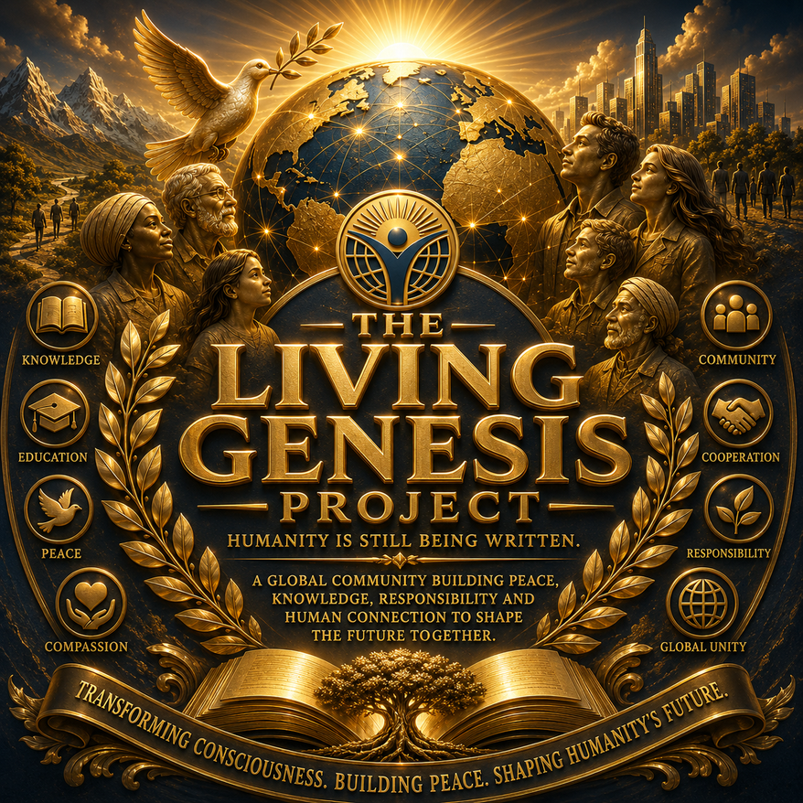


CONTACT US FOR MORE INFO
Publishing Information
Publisher
Transformation of Essence Foundation
Commercial Rights & Distribution
Consistent Ltd.
VAT Number BG206212994
🏛️
Thank You!
🏢
+359-893-506446
Address: 2 Ilindensko Vastanie Street
7200 Razgrad, Bulgaria
foundation.transformation24@gmail.com
🌐
www.foundation-transformation.org
✍️ Melina Orea
Translation • Publishing • Distribution • Licensing
Together, we bring visionary literature to readers around the world.

